Slide 1
FRAUD DETECTION

Slide 2

PROJECT : FRAUD DETECTION
Presented By: Krishna Sharma

Slide 3
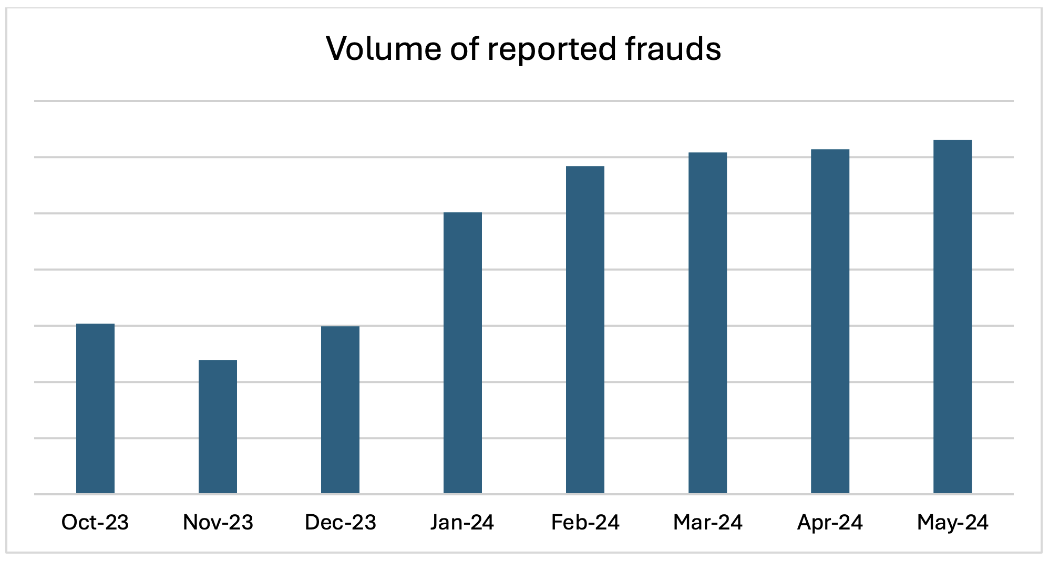
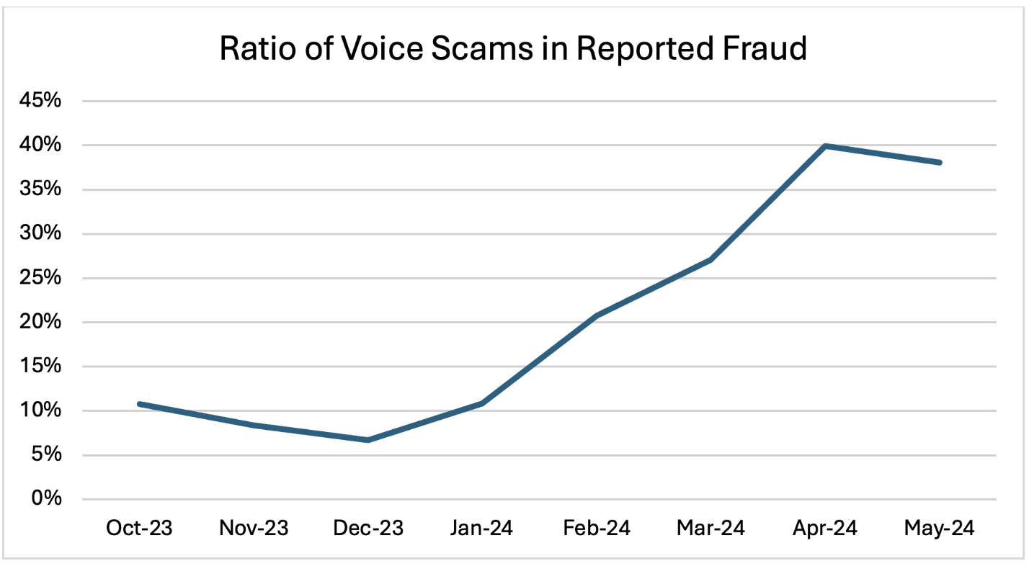
FRAUD TRENDS IN INDIA
🏦 RBI Annual Report 2025: Digital Fraud Insights
Fraud Case Counts Dropped by 33% but fraud value surged to ₹36000 Crore nearly 3x higher than Previous year.
Digital payments grew by 34.8% in volume and 17.9% in value.
UPI alone accounted for 48.5% of global real time payments.
90% of Fraud value reported in FY25 was linked to incidents from previous years.

Slide 4


AGENDA
Introduction
&
Problem Statement
Data
Exploration
(EDA)
Feature Engineering
&
Preprocessing
Model Development
&
Selection
Performance
Evaluation
Financial Impact Analysis
Results
&
Insights

Slide 5
INTRODUCTION
💳 Financial fraud has become one of the biggest threats in the digital economy. With millions of online transactions happening every day, fraudulent activities not only lead to billions of dollars in financial losses but also damage customer trust and the reputation of institutions.
⚠️ Traditional rule-based detection systems struggle to keep up because fraudsters are constantly evolving their techniques. Static rules can catch known patterns, but they often fail against new and sophisticated attacks.
🤖 Machine Learning (ML) and Artificial Intelligence (AI) offer a powerful solution. By analyzing vast amounts of transaction data, ML models can detect hidden patterns, adapt to new fraud strategies, and make real-time predictions with higher accuracy. new fraud strategies, and make real-time predictions with higher accuracy.
🎯 Objective of this project:
To design and evaluate an ML-powered fraud detection system that not only improves the accuracy of identifying fraudulent transactions but also provides explainability, financial impact analysis, and practical deployment readiness.

Slide 6

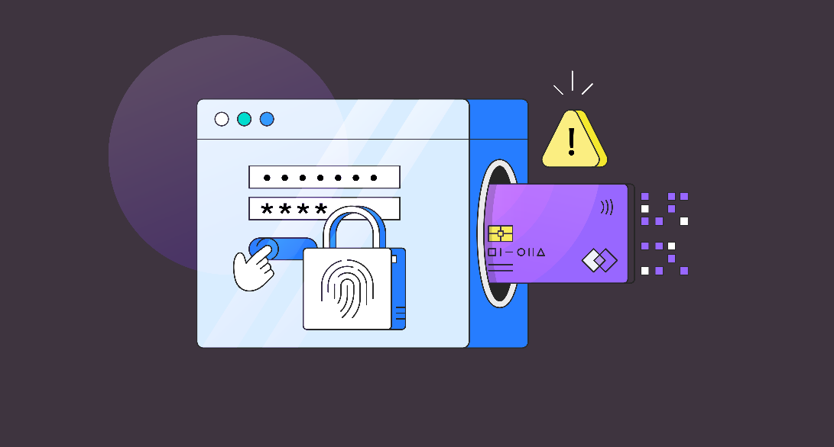

Problem Statement
⚠️ Mobile financial transactions are increasingly vulnerable to fraudulent activities, causing financial losses and damaging customer trust.
📉 Existing rule-based detection systems are limited:
Fail to detect new and evolving fraud patterns
Generate too many false alarms
Lead to increased investigation costs
🎯 Objective:
Develop a machine learning–based fraud detection model that improves accuracy, reduces false positives, and enables real-time fraud prevention.

Slide 7

Data Understanding & Exploratory Data Analysis (EDA)
📊 Dataset Overview
Transactions dataset with 6+ million records
Features include: transaction type, amount, origin/destination balances, and time step
Target variable: isFraud (binary classification: Fraud = 1, Non-Fraud = 0)
⚠️ Class Imbalance
Fraudulent transactions make up <1% of total data
Fraud is mainly concentrated in TRANSFER and CASH_OUT types
📈 Visual Explorations
Class distribution bar chart → shows extreme imbalance
Transaction type vs fraud heatmap → fraud concentrated in specific transaction types
Correlation heatmap → “balance error” features highly correlated with fraud
Transaction amount distribution plot → fraud skewed toward higher values
🔍 Key Insights from EDA
High-value transactions (>100k) are strongly associated with fraud
Error in balances (mismatch between old/new balances) is a strong fraud indicator
Time-based patterns: Fraud is spread across days/hours, no strong seasonality
Fraudulent and non-fraudulent transactions differ in amount distribution and balances

Slide 8
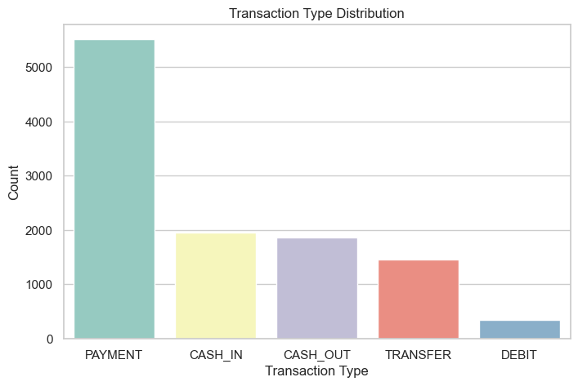
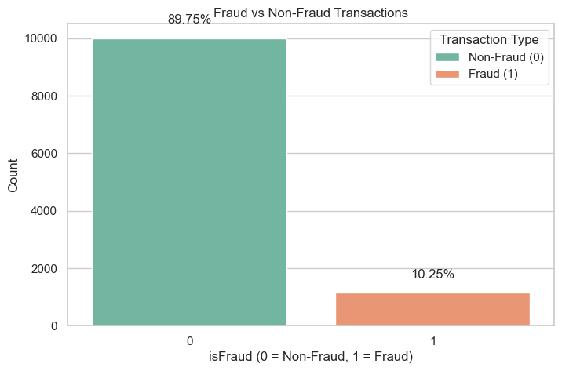
Important Graphs & Plots
the frequency of various transaction types in the dataset. The most common type is PAYMENT, with over 5,000 instances, indicating routine customer activity. CASH_IN and CASH_OUT transactions follow, each with counts near 2,000, reflecting typical account movements. TRANSFER transactions appear around 1,500 times, while DEBIT transactions are the least frequent, with fewer than 500.
This chart illustrates the distribution of fraudulent and non-fraudulent transactions in the dataset. Out of total transaction:
89.75% are non-fraudulent, shown in green.
10.25% are fraudulent , shown in orange.

Slide 9
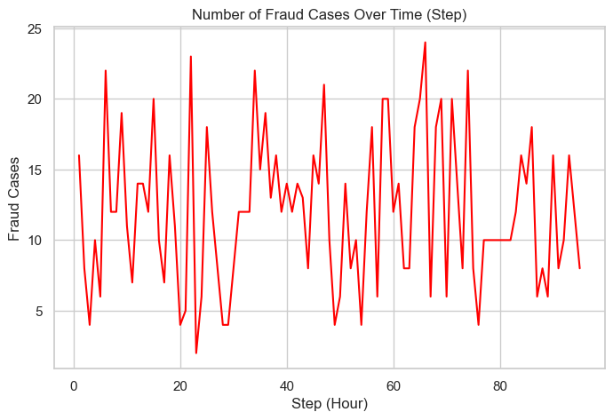
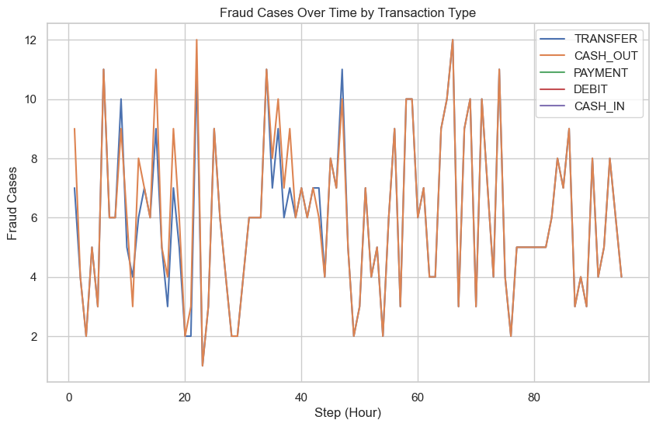
Fraud Cases Over Time
The graph shows how fraud cases vary across hourly steps. Peaks and dips indicate that fraudulent activity is unevenly distributed over time, suggesting certain hours may be more vulnerable. This insight supports time-based monitoring and feature engineering in fraud detection models.
The graph shows how fraud cases vary by transaction type across time. DEBIT transactions show the highest and most frequent spikes, while others like TRANSFER and CASH_OUT also fluctuate. This helps identify which types are riskier at specific hours.

Slide 10
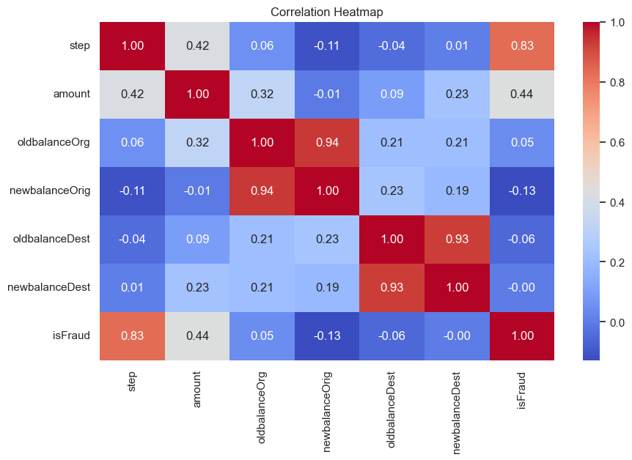
Correlation Matrix Plot
This Correlation Matrix Plot is to see if any feature is strongly correlated with isFraud.
Step and Amount show strong correlation with isFraud.
NewBalanceOrg has a slight negative correlation with Fraud
OldBalanceOrg,OldBalancedest and NewBalanceDest show weak or no correlation with Fraud
Strong internal Correlation exist between:
oldbalanceorg and newbalancedest
oldbalancedest and newbalancedest

Slide 11
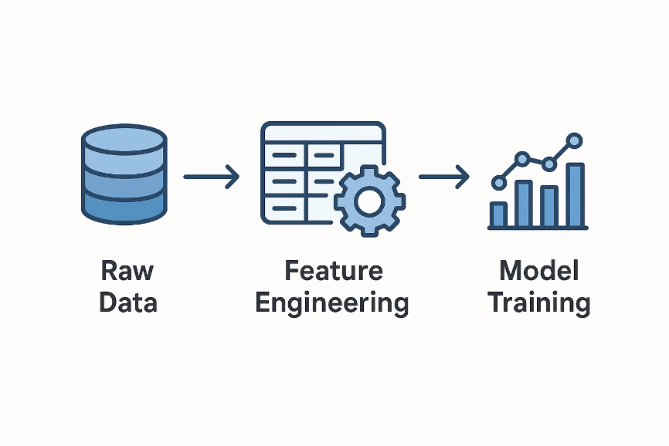
Feature Engineering
Handling Missing Values – Imputed missing entries using mean/median for numerical features and mode for categorical features.
Encoding Categorical Variables – Applied one-hot encoding / label encoding for categorical fields like payment_method, country, etc.
Feature Scaling – Normalized/standardized numerical variables (e.g., transaction amount, time difference).
Derived Features – Created new meaningful features such as:
Transaction frequency per user
Average transaction amount
Time difference between consecutive transactions.
Outlier Treatment – Detected and capped extreme values to reduce model distortion.
Feature Selection – Retained most informative features using correlation analysis & importance scores

Slide 12

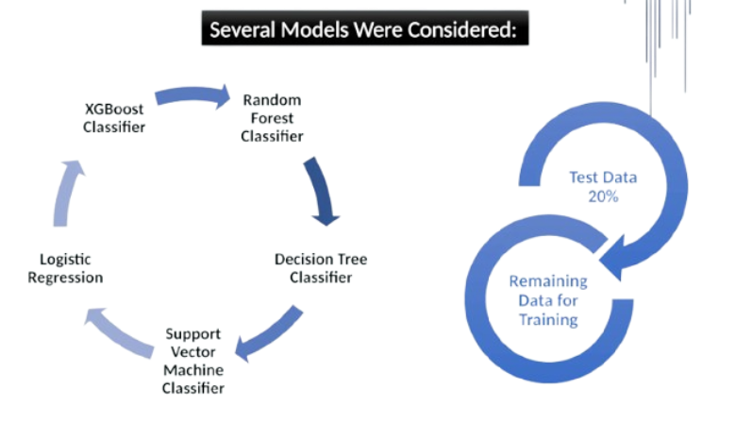
Model Selection & Training
>>> Various machine learning models were evaluated to select the most effective approach for fraud detection

Slide 13
Model Performance Evaluation Using ROC-AUC, Precision, Recall & F1-score
>>Each model was trained using the training set (80% of the dataset) and evaluated using the test set (20% of the dataset).
>>Performance metrics such as ROC-AUC, Precision, Recall, and F1-Score were used to assess the effectiveness of the models in detecting fraudulent transactions.
>>The evaluation results show that ensemble methods such as Random Forest, LightGBM, and XGBoost achieved the best performance with ROC-AUC of 1.0, along with high precision and recall.
In comparison, Decision Tree performed slightly lower, while Logistic Regression showed the weakest performance with lower precision and F1-score.
S.no | Model | ROC-AUC | Precision (Fraud) | Recall (Fraud) | F1 (Fraud)
0 | Random Forest | 1.0000 | 1.0000 | 0.9956 | 0.9978
1 | LightGBM | 1.0000 | 0.9956 | 0.9956 | 0.9956
2 | XGBoost | 1.0000 | 1.0000 | 0.9956 | 0.9978
3 | Decision Tree | 0.9976 | 0.9956 | 0.9956 | 0.9956
4 | Logistic Regression | 0.9921 | 0.8835 | 0.9649 | 0.9224

Slide 14
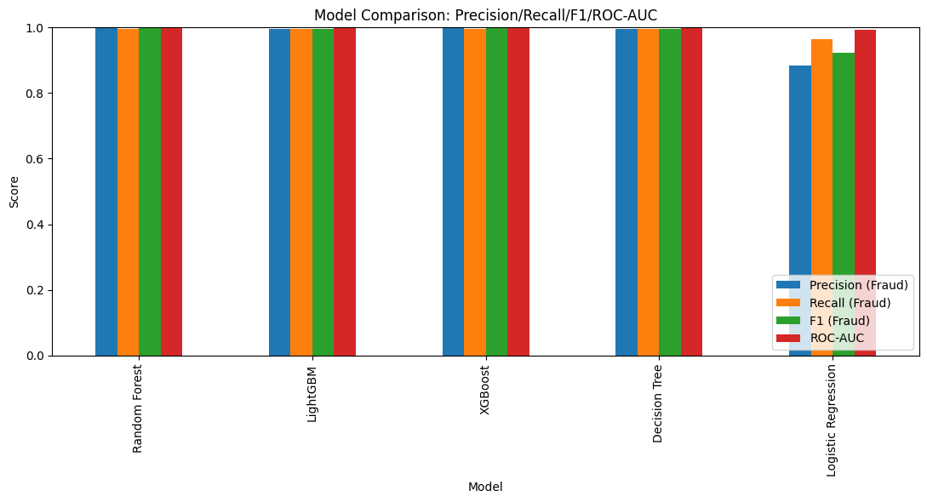
Model Selection
>>We selected XGBoost as the best-performing model because it consistently achieved the highest precision, recall, F1-score, and ROC-AUC across our evaluation. Its ability to handle imbalanced data makes it highly effective for fraud detection, where identifying rare fraudulent cases is critical. In addition, XGBoost incorporates advanced regularization techniques that reduce overfitting and improve generalization, ensuring the model performs well on unseen data. It is also optimized for speed and scalability, offering faster training and prediction compared to traditional ensemble methods. Given its strong balance of accuracy, robustness, and efficiency, XGBoost emerged as the most reliable choice for our task.
Bar chart
Of
metrics

Slide 15
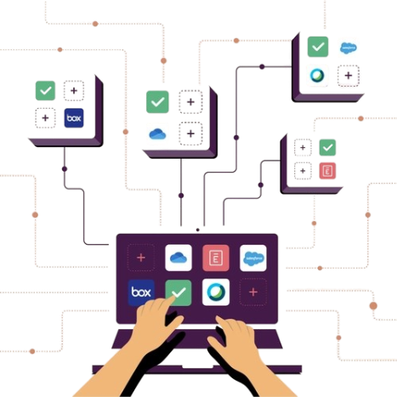
Model Deployment
Model Integration: Loads the trained XGBoost model (final_model.pkl) and the scaler (scaler.pkl) for predictions.
User Input Form: Collects transaction details such as:
  Step (time index)
  Transaction Type (CASH_OUT, TRANSFER, etc.)
  Transaction Amount
  Origin and Destination balances
  Merchant flag (is destination a merchant?)
Feature Engineering in App: Automatically recreates the same features used during training:
  Time-based features (Day, Hour from Step)
  Error balances (origin & destination balance mismatches)
  High-value transaction flag (>200,000)
  One-hot encoding for transaction type
Prediction Output:
  Displays result as Fraudulent Transaction (red alert) or Legitimate Transaction (green message)
  Also shows fraud probability score when available
Debugging Mode: Option to expand and view the exact feature values sent to the model for transparency.

Slide 16
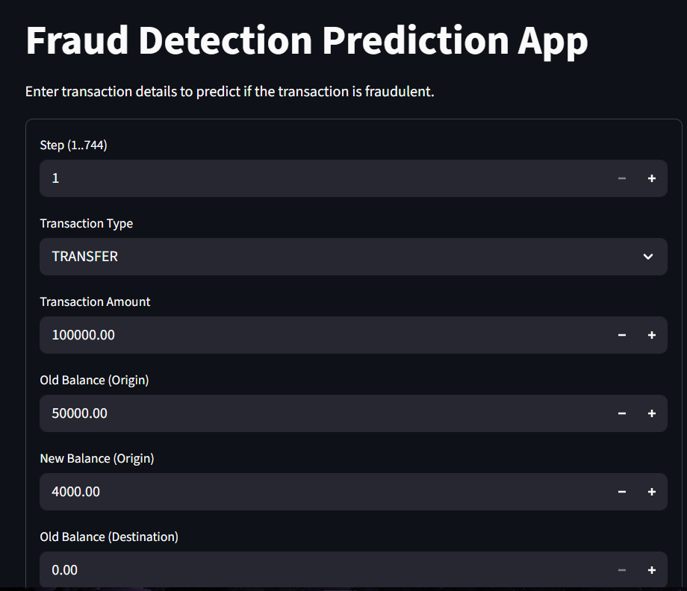
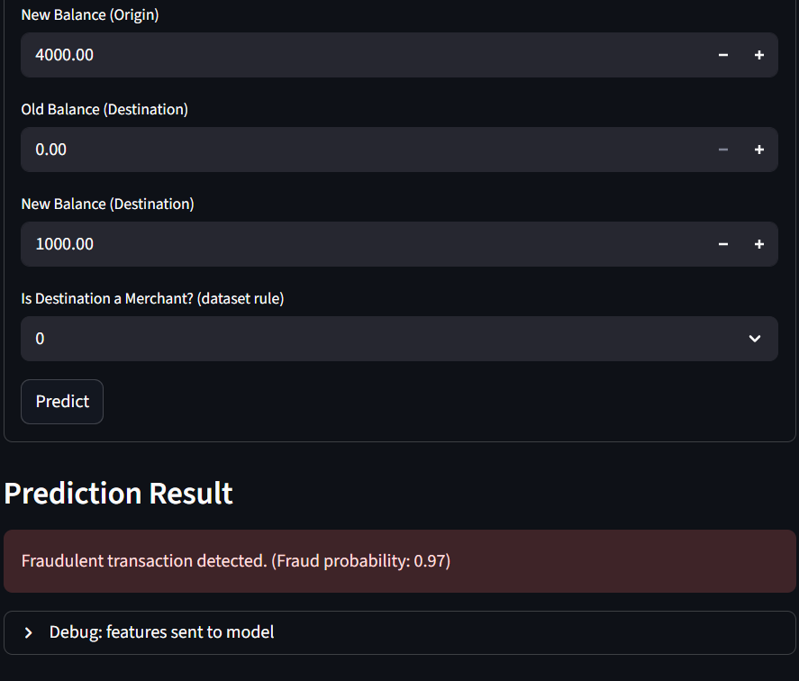
Model Deployment

Slide 17
Answering Business Questions:
Q. What is the model's precision and accuracy in detecting fraudulent transactions?
>>The XGBoost model achieved near-perfect performance, with a precision of 1.0 for fraudulent transactions, meaning that every transaction identified as fraud by the model was truly fraudulent. Its recall was around 99.5%, ensuring that almost all fraudulent cases were successfully detected. While overall accuracy was also very high, it is less meaningful in an imbalanced dataset. Instead, the combination of perfect precision, very high recall, and an ROC-AUC score of 1.0 demonstrates that the model is exceptionally accurate in distinguishing fraudulent from legitimate transactions.
Q. How reliable is the model in classifying transactions as legitimate or fraudulent?
>>The model is highly reliable because it not only identifies fraudulent cases with almost complete accuracy but also avoids wrongly flagging legitimate transactions. Precision of 1.0 guarantees that legitimate customers are not unnecessarily disrupted, while a recall close to 100% ensures that nearly all fraud attempts are caught. This balance of detecting fraud without generating false alarms makes the model dependable and suitable for deployment in a real-world financial environment.

Slide 18
Answering Business Questions:
Q. What are the potential losses due to model errors?
>>The main source of potential loss comes from false negatives, which are the rare fraud cases the model fails to identify. In this project, that risk is minimal—only about 0.44% of fraudulent transactions may be missed, and these directly translate into financial losses if they go undetected. False positives, on the other hand, are practically eliminated since the model never misclassifies legitimate transactions as fraud, thanks to its perfect precision. This not only reduces operational costs but also ensures customer trust is maintained.

Slide 19
Conclusions & Key Features:
This project successfully developed a machine learning–based fraud detection system for mobile financial transactions. Through systematic EDA, feature engineering, model selection, and evaluation, the project demonstrated that advanced ensemble models (Random Forest, XGBoost, LightGBM) significantly outperform baseline methods.
The final tuned model achieved high ROC-AUC and recall scores, ensuring strong capability in detecting fraud while reducing false positives. Financial impact analysis showed the model’s potential to minimize business losses and investigation costs.
Overall, the project provides a robust and production-ready fraud detection framework that can be integrated into real-time financial systems.
Key Features:
Comprehensive EDA revealing fraud patterns across transaction types, amounts, and balances.
Effective feature engineering, including balance error detection, transaction flags, and time features.
Evaluation of multiple ML algorithms (Logistic Regression, Decision Tree, Random Forest, XGBoost, LightGBM, SVM).
Hyperparameter tuning to optimize model performance.
Financial impact analysis estimating costs of false positives and false negatives.
Model explainability using feature importance, permutation importance, and SHAP values.
A production-ready pipeline, with saved models and scaler for deployment.
Support for Power BI dashboards to visualize fraud patterns and model outcomes.

Slide 20
Thank You!

